Slide 1
Chapter 3 Stacks and Queues
Notes:
第三章 栈和队列

Slide 2


3.1 The Stack Abstract Data Type
Stack
  An ordered list in which insertions and deletions are made at one end called the top only.
  Last - In - First - Out ( L I F O )
  Stack S = (a₀, …, a_{n-1})
  a₀ -- the bottom element a_{n-1} -- the top element
6
5
6
5
4
3
5
2
6
1
Notes:
栈的抽象数据类型
栈：一个有序的列表，插入和删除操作只能在一端（栈顶）进行。
后进先出
数组表达：a₀为栈底，a_{n-1}为栈顶

Slide 3
Example:
System stack after function call
old frame ptr.
fp
return address
a1
local variables
old frame ptr.
old frame ptr.
fp
return address
return address
main
Notes:
栈的例子：
系统栈

Slide 4
ADT Stack is
Object: a finite ordered list with zero or more elements.
Functions:
for all stack ∈ Stack, item ∈ element, max_stack_size ∈ positive integer
Stack CreateS(max_stack_size) ::=
create an empty stack whose maximum size is max_stack_size
Boolean IsFull(stack, max_stack_size) ::=
if ( number of elements in stack == max_stack_size )
return TRUE
else return FALSE
Stack Push(stack, item) ::=
if ( IsFull(stack) ) stack_full
else insert item into top of stack and return
Boolean IsEmpty(stack) ::=
if ( stack == CreateS(max_stack_size) ) return TRUE
else return FALSE
Element Pop(stack) ::=
if ( IsEmpty(stack) ) return
else remove and return the item on the top of the stack
Notes:
栈的ADT

Slide 5
Representation and Operations
Representation
  Stack CreateS ( max_stack_size ) ::=
  #define MAX_STACK_SIZE 100 /*maximum stack size */
  typedef struct {
  int key;
  /* other fields */
  } element;
  element stack [ MAX_STACK_SIZE ];
  int top = -1;
Operations
  Boolean IsEmpty(stack) ::= top < 0;
  Boolean IsFull(stack) ::= top >= max_stack_size - 1;
  Add to a stack
  Delete from a stack
Notes:
栈的表达与操作

Slide 6
【example】Add to a stack and Delete from a stack
void push(int *top, element item)
{ /* add an item to the global stack */
if ( *top >= MAX_STACK_SIZE -1 ) {
stack_full();
return;
}
stack[++*top] = item;
}
element pop(int *top)
{ /* return the top element from the stack */
if ( *top == -1 )
return stack_empty( ); /* return an error key */
return stack[(*top)--];
}
Notes:
Push和pop操作

Slide 7
栈的应用举例
例 数制转换
算法基于原理：
N=(N div d) *d +N mod d

Slide 8
例如：(1348)₁₀=(2504)₈
其运算过程如下：
N N div 8 N mod 8
348 168 4
168 21 0
21 2 5
2 0 2

Slide 9
void conversion( ) {
s = CreateS(MAX_STACK_SIZE);
scanf(“%d”,&n);
while (n) {
push(s,n%8);
n=n/8;
}
while (!IsEmpty(s)){
e = pop(s);
printf(“%d”,e);
}
}//conversion

Slide 10
void stackFull()
{
fprintf(stderr, “Stack is full, cannot add element”);
exit(EXIT_FAILURE);
}
Notes:
Stackfull处理（版本一）
只需要打印出错信息，退出程序

Slide 11
3.2 Stack using Dynamic Arrays
Stack CreateS() ::= typedef struct {
int key;
/*other fields*/
} element;
element *stack;
MALLOC(stack, sizeof(*stack));
int capacity = 1;
int top = -1;
Boolean IsEmpty(Stack) ::= top<0;
Boolean IsFull(Stack) ::= top >= capacity – 1;
Notes:
用动态数组实现栈
起始状态：一个单位长度
每次遇到栈满，分配两倍的空间
增加维护一个数据capacity，保存当前栈空间的容量

Slide 12
void stackFull()
{
REALLOC(stack, 2* capacity * sizeof(*stack));
capacity *= 2;
}
Notes:
Stackfull操作版本2，分配双倍空间
注意：REALLOC是宏定义，书上有相应的定义，建议编程时直接使用realloc函数

Slide 13
3.3 Queues
4
Queue
  An ordered list in which all insertions take place at one end and all deletions take place at the opposite end.
  First - in - First - Out (FIFO)
  queue Q = (a₀, …, a_{n-1})
  a₀ -- the front element
  a_{n-1} -- the rear
3
2
1
2
1
2
1
Notes:
队列：
一个有序的列表，插入操作在一段进行，删除操作在另一端进行
先进先出
队首和队尾

Slide 14
Queue Abstract Data Type
structure Queue is
object: a finite ordered list with zero or more elements.
functions:
for all queue∈ Queue, item∈ element, max_queue_size∈ positive integer
Queue CreateQ(max_queue_size) ::=
create an empty queue whose maximum size is max_queue_size
Boolean IsFullQ(queue, max_queue_size) ::=
if ( number of elements in queue == max_queue_size ) return TRUE
else return FALSE
Queue AddQ(queue, item) ::=
if ( IsFullQ(queue) ) queue_full
else insert item at rear of queue and return queue
Boolean IsEmptyQ(queue) ::=
if ( queue == CreatQ(max_queue_size) ) return TRUE
else return FALSE
Element DeleteQ( queue) ::=
if ( IsEmptyQ( queue ) ) return
else remove and return the item at front of queue
Notes:
队列的抽象数据类型

Slide 15
Representation and Operations
Representation
  Queue CreateQ ( max_queue_size ) ::=
  #define MAX_QUEUE_SIZE 100 /*maximum queue size */
  typedef struct {
  int key;
  /* other fields */
  } element;
  element queue [ MAX_QUEUE_SIZE ];
  int rear = -1;
  int front = -1;
Operations
  Boolean IsEmptyQ(queue) ::= front == rear;
  Boolean IsFullQ(queue) ::= rear == max_queue_size - 1;
  Add to a queue
  Delete from a queue
Notes:
队列的表达和操作

Slide 16
【example】 Add to a queue and Delete from a queue
void addq(int *rear, element item)
{ /* add an item to the queue */
if ( *rear == MAX_QUEUE_SIZE -1 ) {
queue_full( );
return;
}
queue[++*rear] = item;
}
element deleteq(int *front, int rear)
{ /* remove element at the front of the queue */
if ( *front == rear )
return queue_empty( ); /* return an error key */
return queue[++*front];
}
Notes:
插入和删除操作

Slide 17

【example】Job scheduling
−1
0
1
2
3
4
5
6
Job 1
Job 2
Job 3
Job 4
Job 5
Job 6
Job 7
front
rear
rear
rear
rear
rear
rear
rear
front
 Push Job 1
 Push Job 2
 Push Job 3
 Pop Job 1
 Push Job 4
 Push Job 5
 Push Job 6
 Pop Job 2
 Push Job 7
 Push Job 8
queue_full ( ) ::= move the entire queue to the left, so that the first element is again at queue [ 0 ], front is at −1, and rear is also correctly positioned.
The worst case T_{queue_full} = O( MAX_QUEUE_SIZE )
Notes:
应用：工作安排
队列满时的特殊处理：将整个队列移动到从0号元素开始

Slide 18

Circular Queues
rear
[ 5 ]
[ 0 ]
rear
Question:
Why is the queue
announced full
while there is
still a free
space left?
front
rear
 Push Job 1
rear
Job
5
Job
6
front
 Push Job 2
rear
Do you have
a better idea?
front
Are you kidding?
Of course I do!
rear
 Push Job 3
Job
4
Job
1
[ 4 ]
[ 1 ]
 Pop Job 1
 Push Job 4
Job
3
Job
2
 Push Job 5
rear
rear
The queue
is full
 Push Job 6
The queue
is full
[ 3 ]
[ 2 ]
 Push Job 7
Note: We should rotate rear and front before we push or pop any item.
Notes:
循环队列，有一个位置不能使用
用两个位置标记来标注队首和队尾

Slide 19
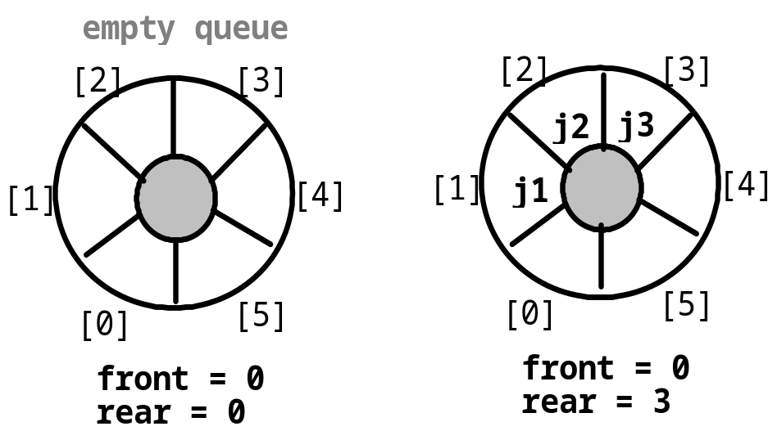
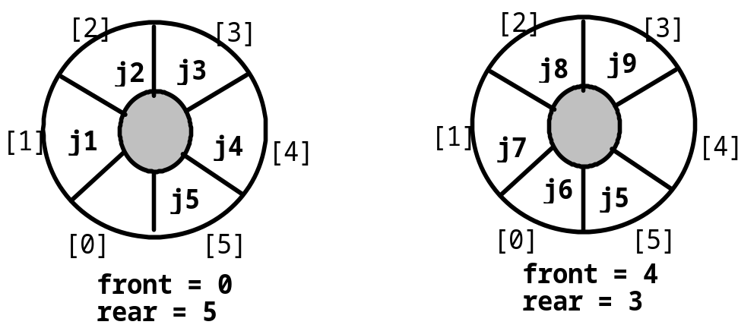
Circular Queues
front ==rear (empty queue )
front ==(rear +1)%max (full queue )
Queue CreateQ( max_queue_size )::=
#define MAX_QUEUE_SIZE 100
typedef struct {
int key ;
/* other fields */
} element ;
element queue [ MAX_STACK_SIZE ] ;
int rear = 0, front = 0 ;
*rear = (*rear + 1) % MAX_AUEUE_SIZE;
*front = (*front+1) % MAX_QUEUE_SIZE;
Notes:
Front == rear表示空队列
Front == (rear + 1) % max表示满队列

Slide 20
【example】Add to a circular queue and delete
void addq(int front, int *rear, element item)
{ /* add an item to the queue */
*rear = (*rear+1) % MAX_QUEUE_SIZE;
if ( front == *rear ) {
queue_full(rear); /* reset rear and print error */
return;
}
queue[*rear] = item;
}
element deleteq(int *front, int rear)
{/* remove front element from the queue and put it in item */
element item;
if ( *front == rear )
return queue_empty( );/* queue_empty returns an error key */
*front = (*front+1) % MAX_QUEUE_SIZE;
return queue[*front];
}
Notes:
循环队列的插入和删除操作

Slide 21
3.4 Circular Queues using Dynamically Allocated Arrays
queueFull()
Copy the first segment to the start of the new queue
Copy the second segment following the first segment
Notes:
用动态数组表示循环队列
关键是队列满时的处理
首先将队列的第一段（从队首到队尾或数组尾）复制到新空间中
接着将队列的第二段（如果存在，从数组头到队尾）复制到新空间

Slide 22
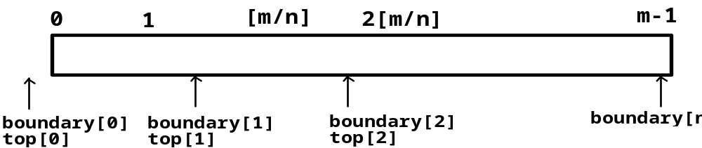
3.7 Multiple Stacks and Queues
Definition
  #define MEMORY_SIZE 100 /* size of memory */
  #define MAX_STACKS 10 /* max number of stacks plus 1*/
  element memory [ MEMORY_SIZE ]; /* global memory declaration */
  int top [ MAX_STACKS ];
  int boundary [ MAX_STACKS ];
  int n ; /* number of stacks entered by the user */
All stacks are empty and divided into roughly equal segments
  top [ 0] = boundary [ 0] = -1;
  for ( i = 1; i < n; i ++ )
  top [ i ] = boundary [ i ] = (MEMORY_SIZE / n ) * i;
  boundary [n ] = MEMORY_SIZE -1;
Notes:
多重栈
为了节约空间，在一个数组中存放多个栈，通过一组边界指示来区分属于某个栈。每个栈之间的空间可以相互借用

Slide 23
Add an item to the stack stack_no
Delete an item from the stack stack_no
void push(int i, element item)
{ /* add an item to the ith stack */
if ( top[i] == boundary[i+1] )
stack_full(i);
memory[++top[i]] = item;
}
element pop(int i)
{ /* remove top element from the ith stack */
if ( top[i] == boundary[i] )
return stack_empty(i);
return memory[top[i] -- ];
}
！Configuration when stack i meet stack i =1, but the memory is not full
b[0] t[0] b[1] t[1] b[i] t[i] t[i+1] t[j] b[j+1] b[n]
b[i+1] b[i+2]

Slide 24
We can design stack_full so that we can add elements to this stack untill the array is full in the following way:
(i) create a space between stack stack_no and stack_no+1.
determine the least j ( stack_no < j < n )such that there is free space between stack j and j + 1 ( top [j ] < boundary[ j + 1 ] ). If there is such a j , then move stack_no +1, stack_no +2,…, j one position to right.
(ii)create a space between stack stack_no and stack_no+1.
look to the left of stack_no, Find the largest j such that 0 <= j < stack_no and there is space between j and j +1 (top [j] < boundary [j + 1]). If there is such a j , move stacks j, j+1,,……, stack_no one space to left.
(iii) If there is no j satisfying either condition (i) or (ii). then all MEMORY_SIZE spaces of memory are utilized and there is no free space. In this case stack_full determinate with an error message.
Notes:
栈满时的处理方式：
将下一个栈后移，空间给当前栈使用；下一个栈也满时候，则同时移动再后面一个栈，以此类推，直到所有栈都满时，才真正是栈满。

Slide 25
Homework
Page 110 1
Page 119 1 2
Page 142 3

